Slide 1

Kaggle Project Report
Reshma, Yang,
Michael, Vincent,
Manaswi, Q

Slide 2
ASHRAE - Great Energy Predictor III
Assessing the value of energy efficiency improvements can be challenging as there's no way to truly know how much energy a building would have used without the improvements. The best we can do is to build counterfactual models. Once a building is overhauled the new (lower) energy consumption is compared against modeled values for the original building to calculate the savings from the retrofit. More accurate models could support better market incentives and enable lower cost financing.
This competition challenges you to build these counterfactual models across four energy types based on historic usage rates and observed weather. The dataset includes three years of hourly meter readings from over one thousand buildings at several different sites around the world.

Slide 3
Datasets (train and test)
building_metadata
site_id, building_id, primary_use, square_feet, year_built, floor_count
test
row_id, building_id, meter, timestamp
train
'building_id', 'meter', 'timestamp', 'meter_reading'
weather_train
'site_id', 'timestamp', 'air_temperature', 'cloud_coverage', 'dew_temperature', 'precip_depth_1_hr', 'sea_level_pressure', 'wind_direction', 'wind_speed'
weather_test
site_id, timestampe, air_temperature, cloud_coverage, 'dew_temperature', 'precip_depth_1_hr', 'sea_level_pressure', 'wind_direction', 'wind_speed'

Slide 4
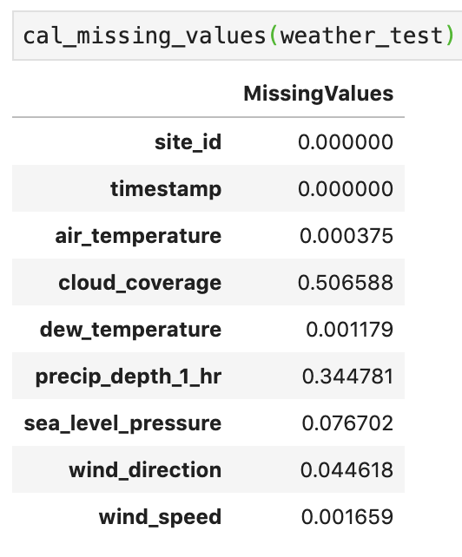
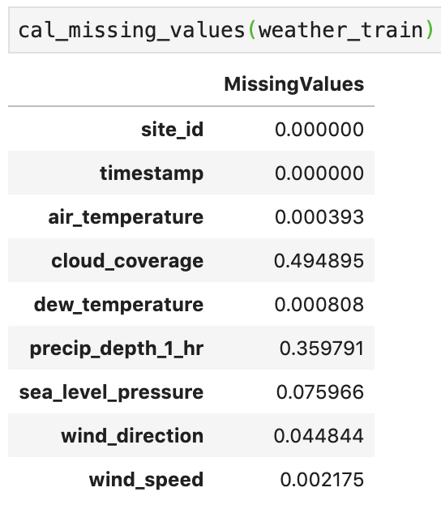
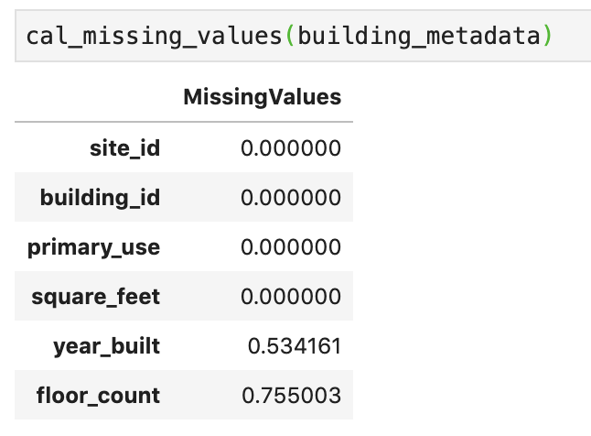
Missing Values
#Check the missing values in each table and dataframe it
def cal_missing_values(df):
data_dict = {}
for i in df.columns:
data_dict[i] = df[i].isnull().sum()/len(df[i])
Dataframe = pd.DataFrame.from_dict(data_dict, orient = "index", columns = ['MissingValues'])
return (Dataframe)

Slide 5
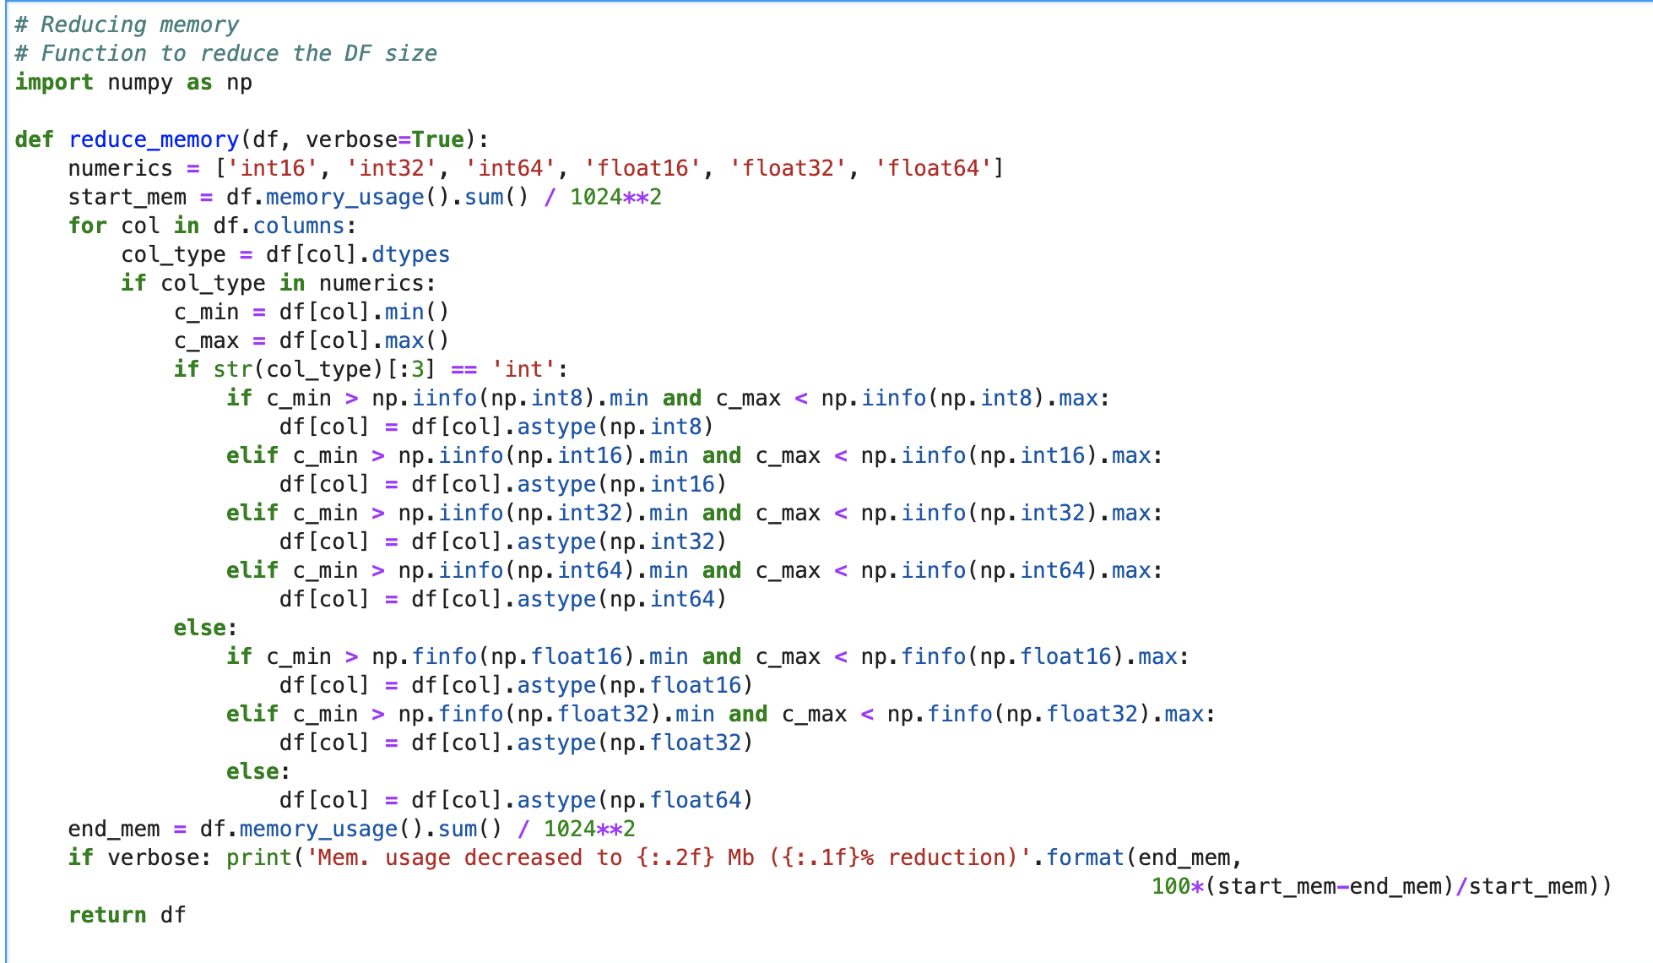
Memory Reduce

Slide 6
Data Exploration and visualization
Data Preprocessing
Feature
Engineering
Predictive Modelling
Understand the problem statement
Explore data and do descriptive study to understand any pattern
Weather train/test data imputation (Rolling mean)
Building metadata imputation (Linear regression)
Timestamp features – day/weekday/ hour/month
Relative humidity
Removed certain rows as discussed on Kaggle forum
Constructed linearRegression, XGB, RandomForest, LightGBMRegressor model

Slide 7
Replacing missing values and Filling with Rolling dates
Example of replacing missing values with mean/median/max/min:
# Adding columns of mean, median, max and min of cloud coverage to replace the missing values
weather_train['cloud_coverage_mean'] = weather_train['cloud_coverage']
weather_train['cloud_coverage_median'] = weather_train['cloud_coverage']
weather_train['cloud_coverage_max'] = weather_train['cloud_coverage']
weather_train['cloud_coverage_min'] = weather_train['cloud_coverage']
weather_train['cloud_coverage_mean'] = weather_train['cloud_coverage_mean'].fillna(np.mean(weather_train.cloud_coverage))
weather_train['cloud_coverage_median'] = weather_train['cloud_coverage_median'].fillna(np.median(weather_train.cloud_coverage))
weather_train['cloud_coverage_max'] = weather_train['cloud_coverage_max'].fillna(np.max(weather_train.cloud_coverage))
weather_train['cloud_coverage_min'] = weather_train['cloud_coverage_min'].fillna(np.min(weather_train.cloud_coverage))
print(weather_train)

Slide 8
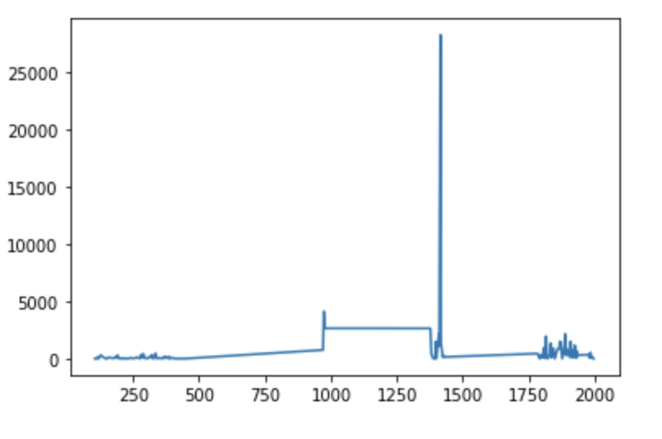
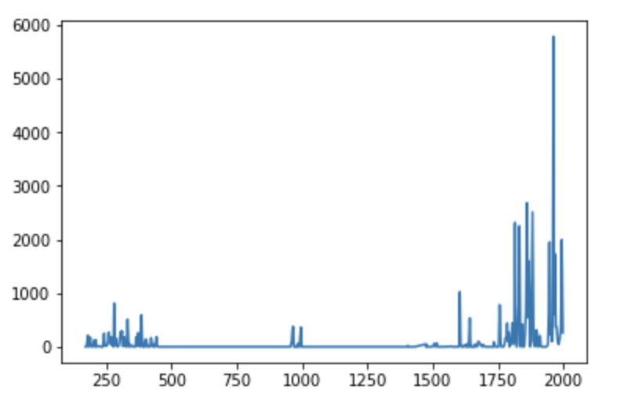
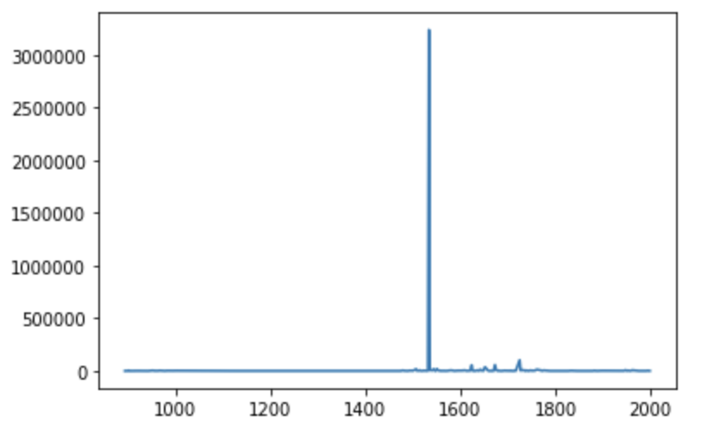
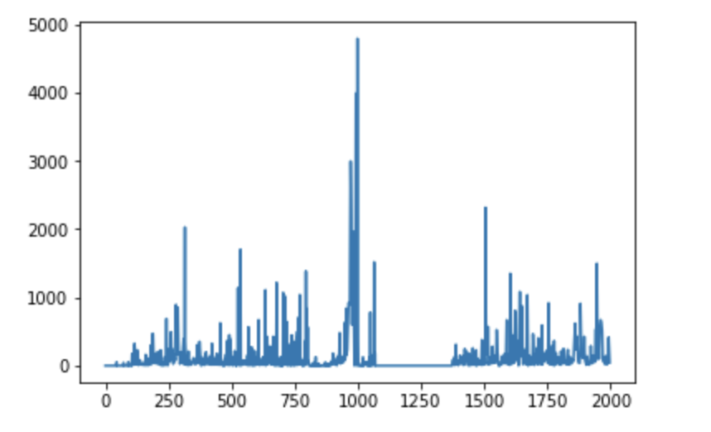
Missing values based on different meter type
Meter = 3
Meter = 1
Meter = 2
Meter = 0

Slide 9
Imputation of missing value with rolling means
def rolling_mean_weather(df, cols, num_of_days):
#assumes that functions will be mean, median, min, max
for col in cols:
for day in num_of_days:
print ("processing missing values for", col, day)
df[col+'_'+'R'+str(day)+'_'+'mean'] = df.groupby('site_id')[col].apply(lambda x: x.fillna(x.rolling(day, center=True, min_periods=1).mean()))
df[col+'_'+'R'+str(day)+'_'+'median'] = df.groupby('site_id')[col].apply(lambda x: x.fillna(x.rolling(day, center=True, min_periods=1).median()))
df[col+'_'+'R'+str(day)+'_'+'min'] = df.groupby('site_id')[col].apply(lambda x: x.fillna(x.rolling(day, center=True, min_periods=1).min()))
df[col+'_'+'R'+str(day)+'_'+'max'] = df.groupby('site_id')[col].apply(lambda x: x.fillna(x.rolling(day, center=True, min_periods=1).max()))
return df
cols_to_impute = ['air_temperature','cloud_coverage','dew_temperature','precip_depth_1_hr', 'sea_level_pressure', 'wind_direction', 'wind_speed' ]
weather_train = rolling_mean_weather(weather_train, cols_to_impute, [3,5,7,14,30])
weather_test = rolling_mean_weather(weather_test, cols_to_impute, [3, 5, 7, 14, 30])

Slide 10
For building & weather
building_fill & weather_fill

Slide 11
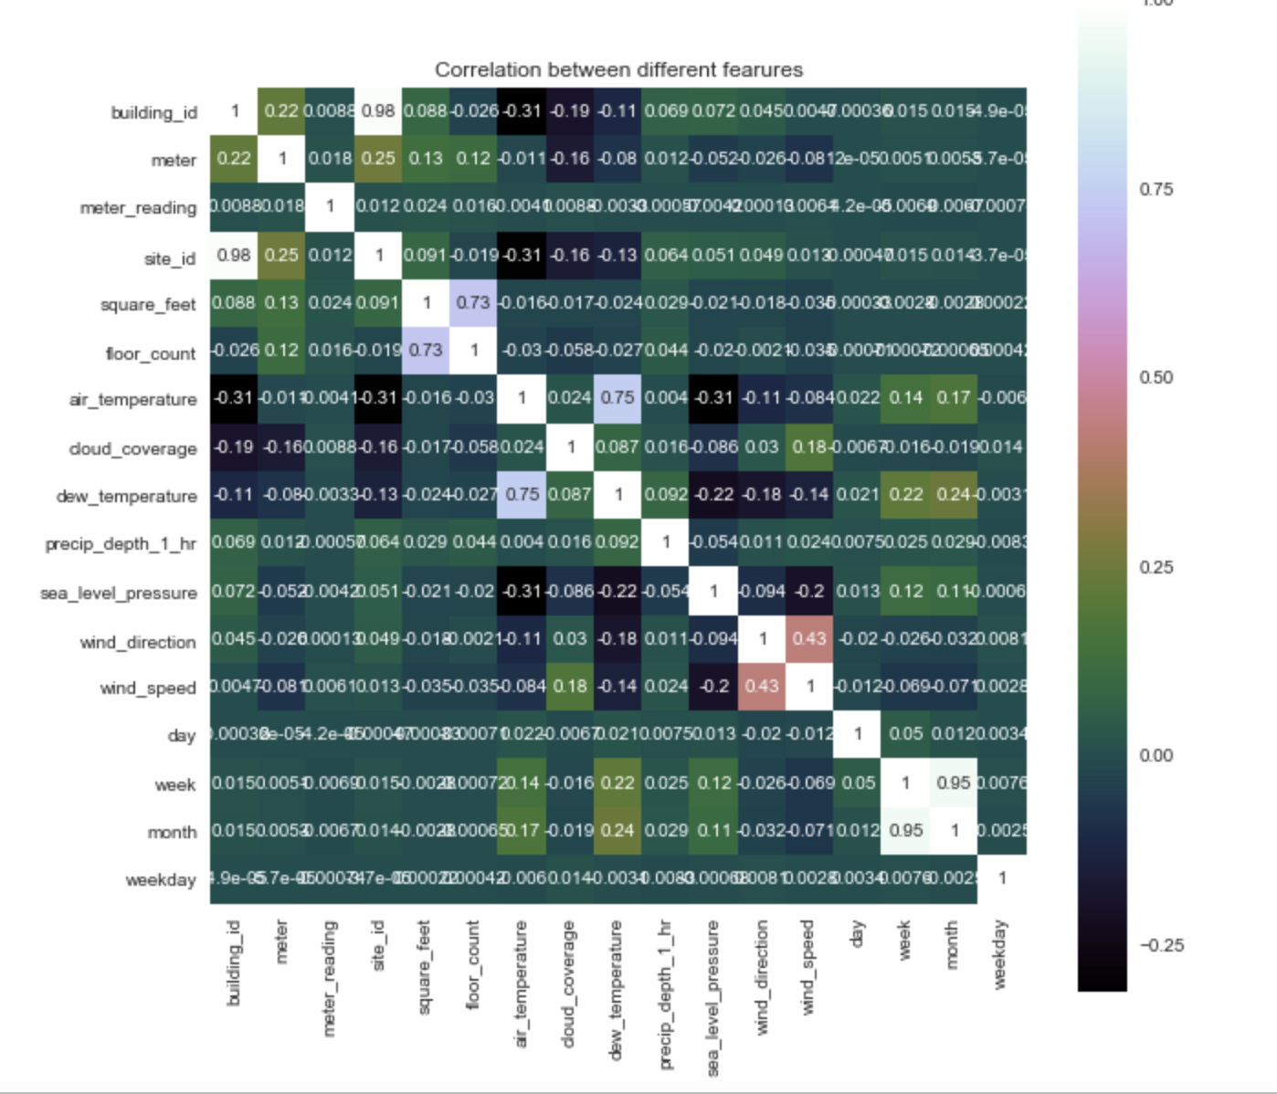
Feature Selection & Engineering
Correlation Matrix with Heatmap (For complete train)

Slide 12
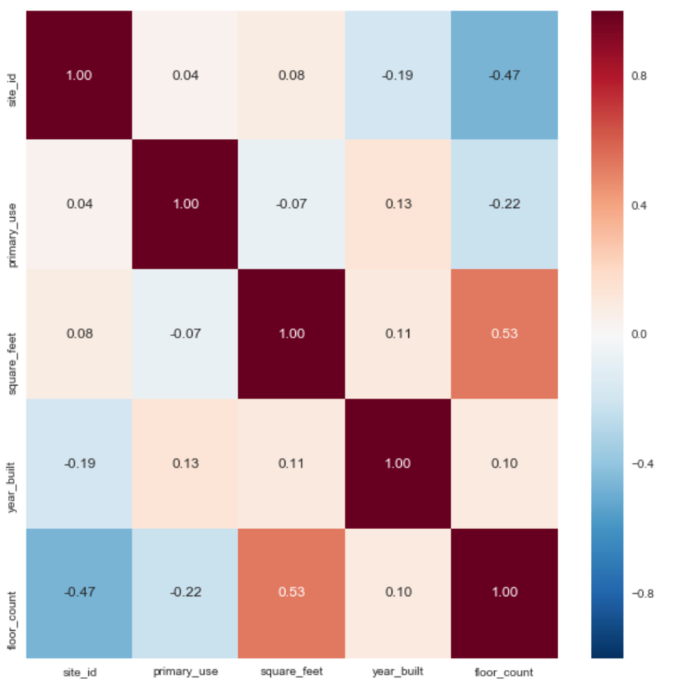
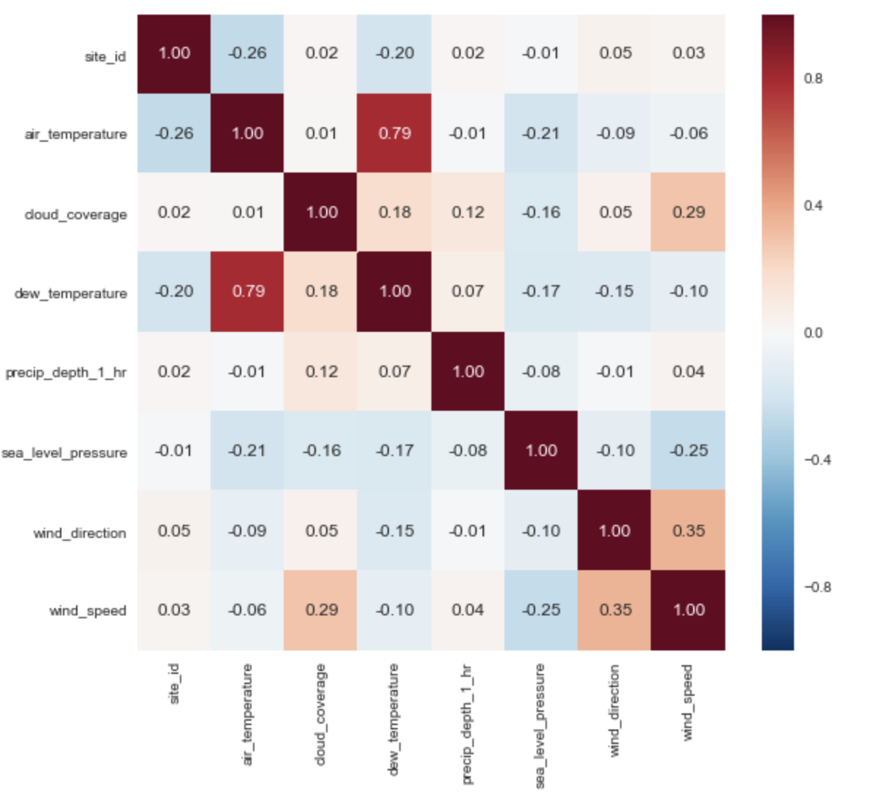
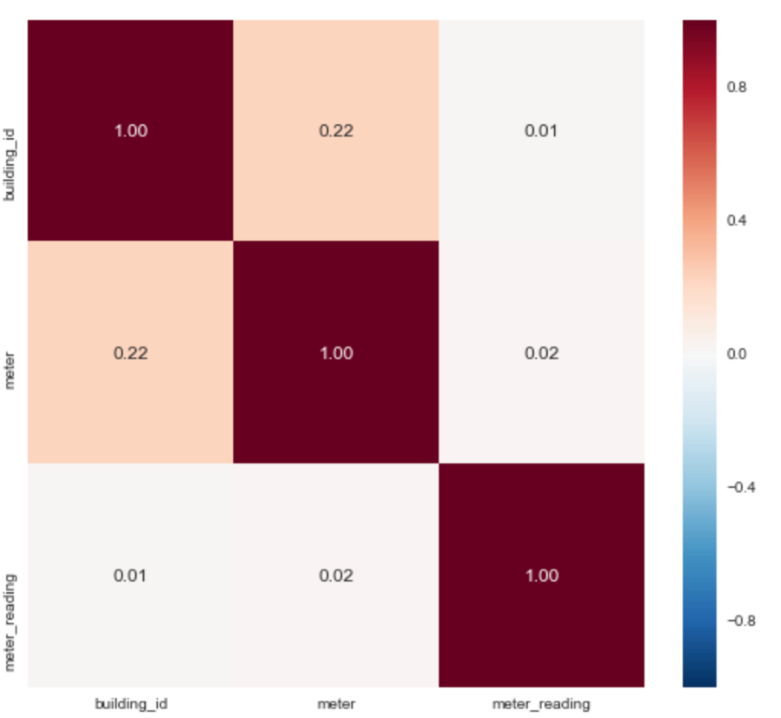
For different datasets (correlation heatmap)
From left to right:
building
weather
meter

Slide 13
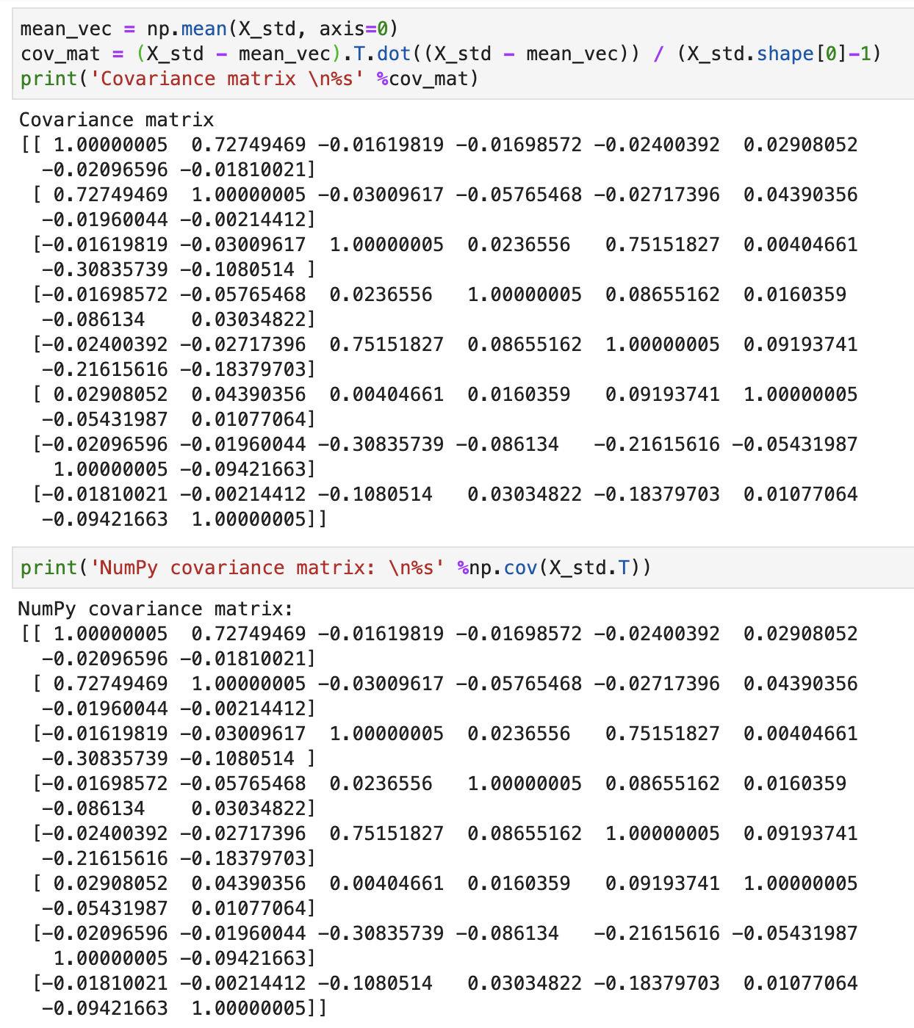
PCA
Drop features:
('site_id', 'building_id', 'day', 'week', 'month', 'timestamp', 'primary_use', 'meter', 'meter_reading’);
Use (StandardScaler) to standardize dataset;
Cor Matrix: -->

Slide 14
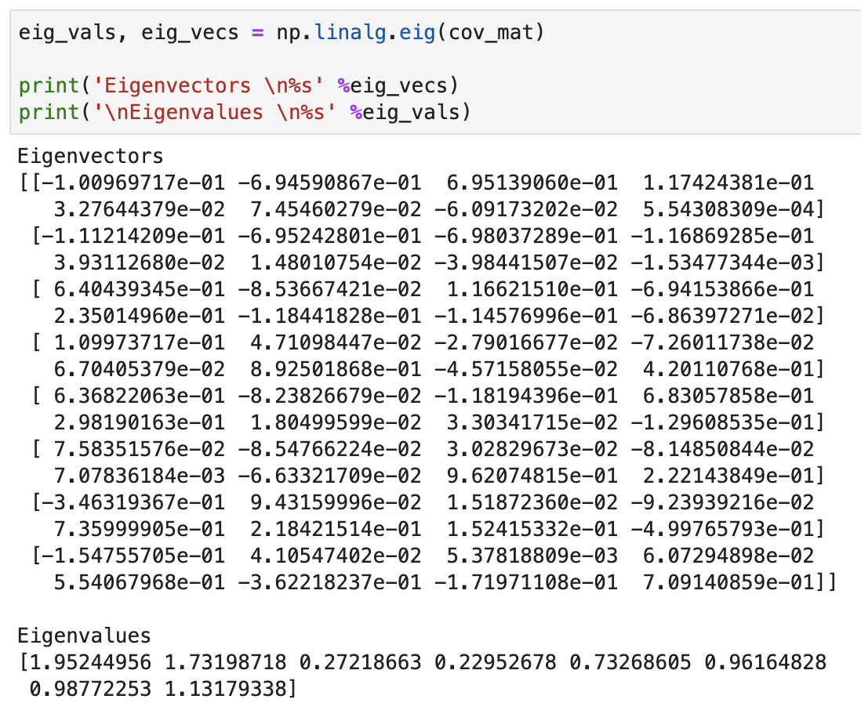
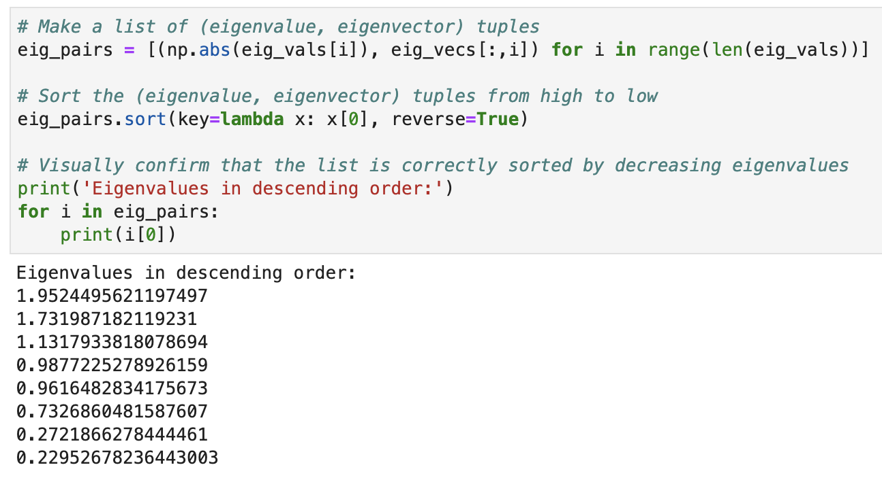
PCA
4. Calculate Eigenvalues and Sort:

Slide 15
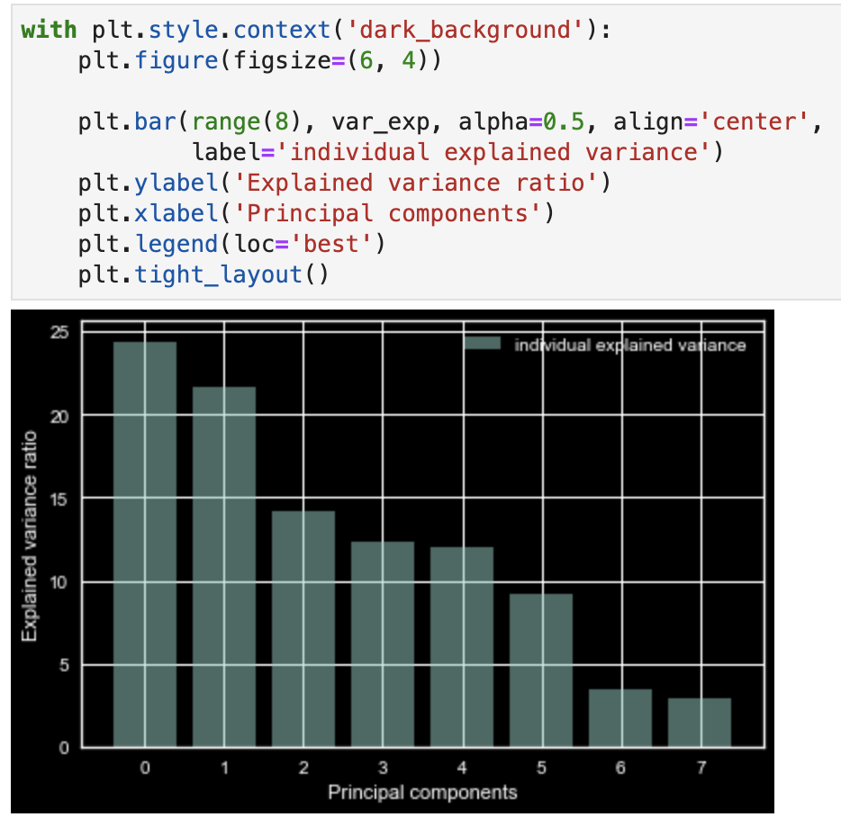
PCA
5. Plot how much each Principle Component can explain

Slide 16
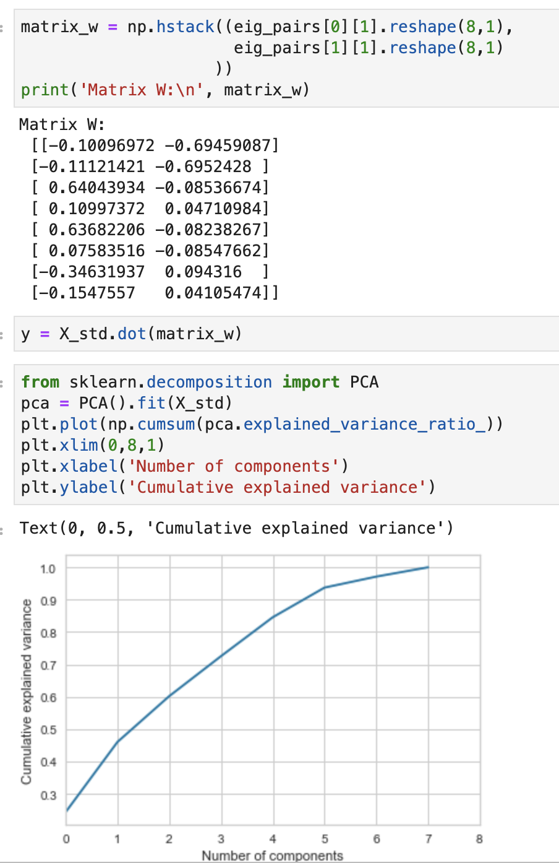
PCA
6. Cumulative Explained Variance

Slide 17
Training Methods and Models
Regression Model (1.87)
Random Forest Regressor (1.53)
XGBoost (No result yet)
Lgbm (1.51)

